Slide 1
Solar ROOFTOP- Challenges & INNOVATIONS TO ACHIEVE 40 GW
India Energy Forum, 16th Renewable Energy Summit 2016
5th Oct, 2016

Slide 2
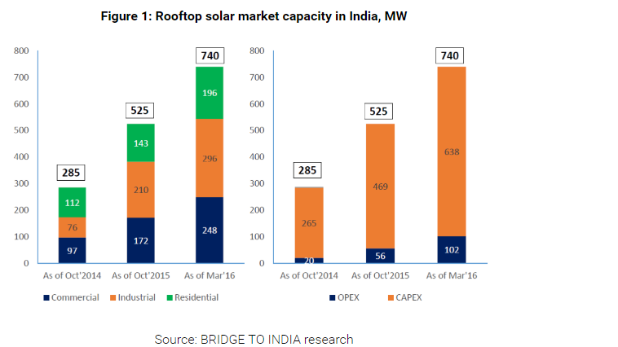
Solar Rooftop PV
Target | 40,000 MW by 2022
Current Status | Installations Progress
Total installations Reach ~ 800 MWp
Capex Model dominates over OPEX model.
Major States
Tamilnadu; Maharastra, Karnataka, Punjab, UP, Rajasthan, AP etc.
Source Bridge 2 India

Slide 3
Solar Rooftop PV
Targets and Progress of Capacity Allotment
SECI Allocations
SECI 500 MW Rooftop – allocation of 30% capital subsidy for 500 MW of residential and institutional rooftop solar projects across India.
SECI rooftop PV projects scheme in select cities. - 8.75 MW has been allocated across 21 projects in nine cities: Chennai, Coimbatore, Delhi, Kolkata, Mumbai, Pune, Palatana, Chandigarh and Gwalior.
SECI bidding- large scale, grid connected rooftop PV systems ranging from 100 kWp to 500 kWp for a total allocation of 11.1 MW. Spread across the cities of Bhubaneswar/Cuttack (1 MW) in Odisha, Gurgaon (1.5 MW) in Haryana, Hyderabad (2 MW) in Andhra Pradesh, Jaipur (3.1 MW) in Rajasthan, Noida/Greater Noida (1.5 MW) in Uttar Pradesh and Raipur/Naya Raipur (2 MW) in Chhattisgarh.
Institutional ( Govt. Bldgs., hospitals, warehouses, schools etc.): 7500 MW
Industrial & commercial sector: 20,000 MW
Housing Sector: 12,500 MW

Slide 4
Solar Rooftop PV
Targets and Progress of Capacity Allotment
Targets
10 GW overall by 2018 for rooftop and other small grid-connected solar projects.
Yearly targets of 2 GW, 4 GW and 4 GW for the three years.
Rooftop allocation to states, UT, PSUs - 1.76 GW
SECI – 950 MW
Min of Railways- 500 MW
PSUs- 317 MW.
Top states wise targets.
Maharashtra (4700 MW), Uttar Pradesh (4300 MW), Tamil Nadu (3500 MW), Gujarat (3200 MW), Karnataka (2300 MW), Rajasthan (2300 MW) and West Bengal (2100 MW)
Institutional ( Govt. Bldgs., hospitals, warehouses, schools etc.): 7500 MW
Industrial & commercial sector: 20,000 MW
Housing Sector: 12,500 MW

Slide 5
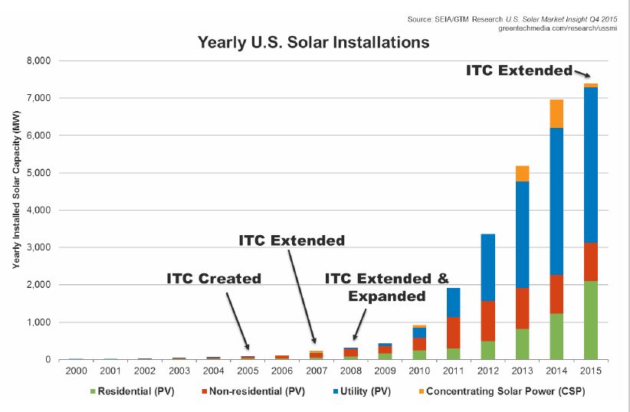
Solar Rooftop PV
Major international Experiences
USA
At the end of Q2, 2016 , US had 31.6 GW of Solar capacity.
- 1.1 Million installations of Rooftop.
- California remains the state with highest solar capacity.
- Although, utility solar dominates, but rooftop solar has progressed consistently largely fuelled by Investment Tax Credit, PACE & Acc. Dep. Related Policies.

Slide 6
Solar Rooftop PV
Germany
Had a total of 39 GW of Solar capacity installed by end of 2015.
Investments are supported by variable FiT for all types of installations.
FiT support varies with highest support offered for Rooftop Solar systems.
Solar capacity installations have significantly reduced in recent years. Year 2015 saw approx 1.5 GW installation
Current FiT for Rooftops of upto 10kW is 12.31 Euro Cents-

Slide 7
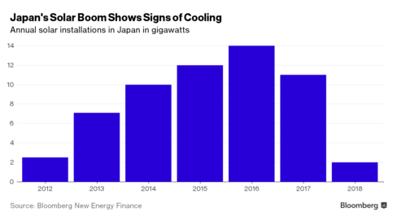
Solar Rooftop PV
JAPAN
Programs are supported by variable FiT policies initiated since 2012.
Rooftop Solar already has 50000 installations.
Market growth is projected to grow for rooftop solar with utility projects expecting slowdown due to infrastructure issues.
Major Policy instruments include.
Clean energy tax break for >10kW non FiT Solar rooftop.
FiT at Yen 24/unit for above 10kW systems for 20 years.
FiT at Yen 31/unit for less than 10kW residential systems for 10 years.

Slide 8
Solar Rooftop PV
Key Aspects
Most leading nations of the world are promoting Rooftop Solar via either of the following policy supports.
Tax Equity Instruments.
Direct Tax benefits.
Fixed Feed in Tariffs.
Variable Feed in Tariffs.
India ‘s Rooftop Solar Incentives
Commercial Segment–
AD Benefit of upto 40% /year.
Local tax incentives as per state schemes.
Additional Residential/Institutional Rooftop Incentives. - Subsidy 30-70% of benchmark/lower project cost.

Slide 9
Advantages of Solar Rooftop PV
Commercial & Technical
•Lower Average Cost of Supply of Solar Energy.
•Reduction in line/T&D losses ( improves efficiency of actual solar energy use).
•Demand Side Management/ Improved power quality.( Large RE related grid issues)
•No land acquisition.
Low Gestation period.

Slide 10
Challenges in Rooftop Solar Financing
Commercial, Industrial & Institutions:
Difficulty in getting long term roof rights/ Lease & Credit strong PPAs with payment security and no termination/loan co-termination provisions.
Limited response from large corporate houses showing interest in RESCO business.
Generation of rooftop projects yet to be established and cannot be generalized, required specific roof analysis.
Seasonal load requirements may lead to longer payback period (e.g. Educational institutions )
Uncertainty on future Industrial expansion which may lead to shifting of solar system.

Slide 11
Way Forward- Rooftop Solar Financing
Support in form of AD/ other incentives should continue.
Availability of low cost dedicated loans for Rooftop Solar to be promoted.
Availability of project performance database on the installed systems under different states.
Cash flow reliability assessment under different net metering schemes.
Strengthening of technical expertise in project structuring for lenders comfort.
Roof Lease Rights/ Power Purchase Agreements.
Roof Shades and Strength analysis.
Technical performance till loan tenure.

Slide 12
IREDA’s loan scheme for Rooftop Solar PV Power Projects
To support Government’s initiative for achieving targets, a new loan scheme launched for setting up of Solar PV Rooftop Power Projects by Industrial, Institutional and Commercial Sectors.
Salient Features:
Applications through Rooftop Solar Aggregators.
Single or different locations.
Minimum total size of the project ≥ 1000 kWp, each system capacity ≥ 20 kWp.
Aggregators to provide credit rating from IREDA empanelled credit rating agencies.
Aggregators responsible for execution & operational performance commitments.

Slide 13
IREDA’s loan scheme for Rooftop Solar PV Power Projects
Terms & Conditions
Interest Rate
9.90% to 10.75% p.a. based on the Credit Rating.
Loan Repayment Period
Up to 9 years
Moratorium
6 to 12 months from the date of COD
Quantum of Loan
70% of the total project cost with min. promoter’s contribution of 30% of the project cost.

Slide 14
IREDA’s sanctions - Commercial & institutional Rooftop Solar PV Power Projects
Applications in Pipeline
Net Metering- 4 MW
Sanctioned so far 12 MW total , includes
10 MW Rooftop – Punjab.
PPA Pvt and Govt – 26 MW
1 MW Karnataka
1 MW UP

Slide 15
Thank You
Indian Renewable Energy Development Agency Limited www.ireda.gov.in

